Slide 1

The best neighborhoodS in Vancouver
The Battle of Neighborhoods

Slide 2
Introduction
Vancouver is unequivocally one of the important Canadian cities. With a recorded population of 2,463,431 in 2016, it is the third largest metropolitan area in canada.
It is a well-known fact that it is also a prominent center for world famous start-ups such as Hootsuite and Slack, numerous museums, entertainment, sports activities, etc.
This begs the question how can it not also be a prominent hub for any kind of business for that matter?

Slide 3
Description of the Data
The project utilizes foursquare location data platform to locate the various restaurants in different neighborhoods in Vancouver.
To provide the necessary information, the project utilized a combination of Vancouver’s 2016 census, which comprises of population, crime rate with foursquare API to find competitors in the same neighborhoods.
Vancouver’s Census data is publicly available at this website: https://opendata.vancouver.ca/pages/home/

Slide 4
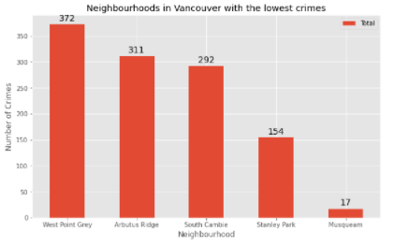

Slide 5
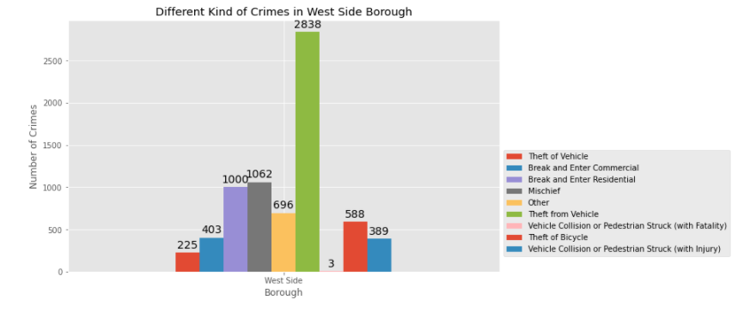

Slide 6
Methodology
The algorithm chosen for this project is k-means clustering. It is an effective method to iteratively assign each data point to one of the K clusters based on feature similarity in neighborhoods.
Moreover, one hot encoding algorithm was also adopted in this project to make the data more expressive.
A few different maps were also used to help an investor to decide the best neighborhood to open a restaurant or for any tourist who wants to locate a safe and best neighborhood in Vancouver based on its income, population, and available competitors.

Slide 7
Results and Discussion
Based on the data analysis, south Vancouver has the lowest crimes. However, it has very little number of neighborhoods and opening a restaurant would not be feasible, so the best course of action is to choose the next borough with the lowest crime which is west side.
Comparing the maps, we can notice that most of the restaurants are grouped on main streets and on the south of the city, although some of the affluent neighborhoods are up to the north. It is also worth noting that the areas with a dense population do not reflect on the number of restaurants.

Slide 8
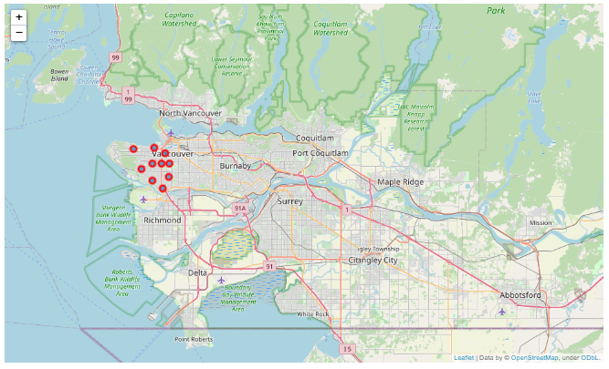
Vancouver’s west side borough

Slide 9
Conclusion
This result of this project may be helpful for someone planning on opening a restaurant in Vancouver and/or for any tourist who might be interested in finding out about the safest and most secure neighborhood to eat out. Nevertheless, it should be noted that not all variables are factored into the project and thus may not be used as a sole decision-making tool.

